Slide 1
SNR-DEPENDENT WAVEFORM PROCESSING FOR
IMPROVING THE ROBUSTNESS OF ASR FRONT-END
Author : Dusan Macho & Yan Ming Cheng
Professor : 陳嘉平
Reporter : 楊治鏞

Slide 2
Outline
Introduction
Basic idea
Algorithm description
Experiment

Slide 3
Introduction(1/2)
Noise reduction
    Spectral Subtraction
    Wiener Filtering
Thus, the assumption of good speech/noise detector is the fundamental weakness of these techniques.

Slide 4
Introduction(2/2)
In this paper, we explore a time domain based method as a complementary approach to the spectrum based speech enhancement techniques

Slide 5
Basic idea
Waveform
SNR
SNR-dependent Waveform Processing (SWP)

Slide 6
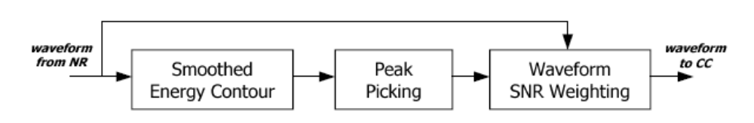
Algorithm description

Slide 7
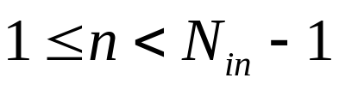
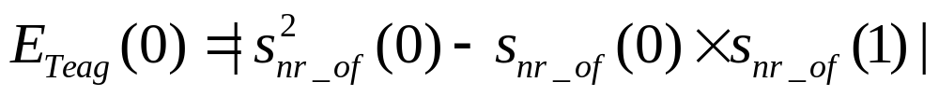
Smoothed energy contour
Teager energy operator

Slide 8
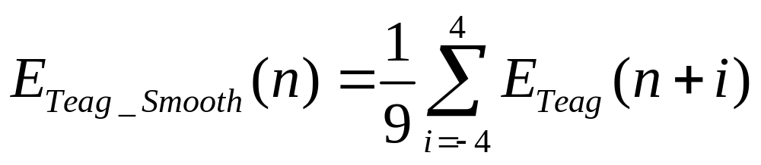
Smoothed energy contour
The energy contour is smoothed by using a simple FIR filter of 9 like

Slide 9
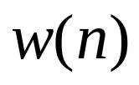

Peak picking
A windowing function is constructed for each frame in such a way that a rectangular unit window of width is placed between each two adjacent maxima found within the frame.
Each maximum is expected to be between 25 and 80 samples away from its neighbor.

Slide 10
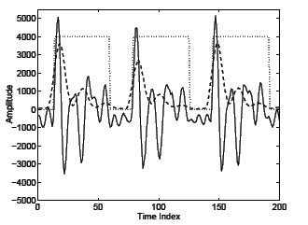

Slide 11
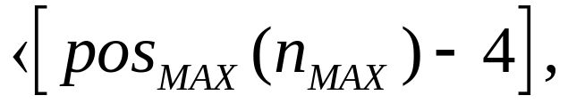

Waveform SNR weighting

Slide 12
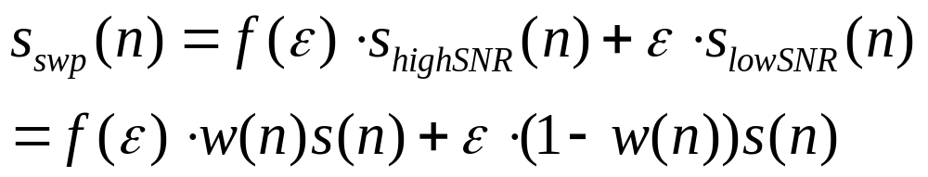
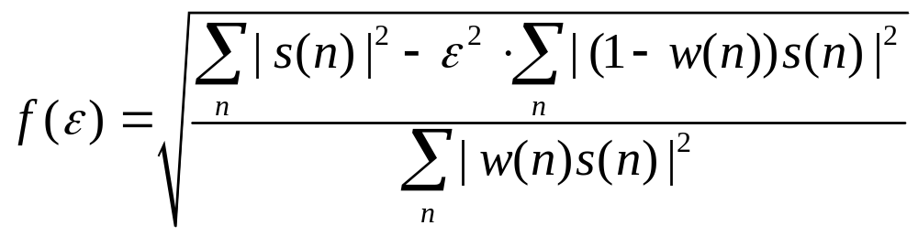


Waveform SNR weighting

Slide 13
Waveform SNR weighting
An important advantage of the SWP is that it does not need a speech/non-speech detector.
SWP is applied after 2MWF, which would have already enhanced the SNR to the adequate level.

Slide 14
Experiment
AURORA 2 database
Multi-condition training (MCT)
Clean speech training (CST)
Testing: A, B, C
Error reduction percentages

Slide 15
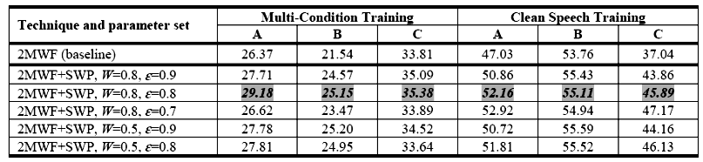
Table 1

Slide 16
Experiment
SWP not only improves noise robustness but also increases the contrast between voiced and unvoiced speech that may help in clean speech recognition.

Slide 17
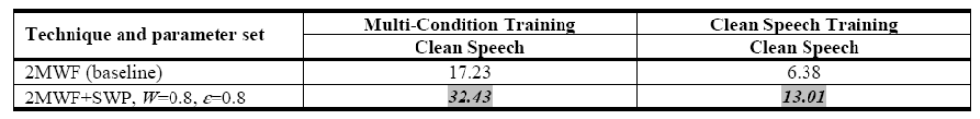
Table 2

Slide 18
Experiment
High SNR : W=0.8
Low SNR : W=0.5
Spectral subtraction

Slide 19
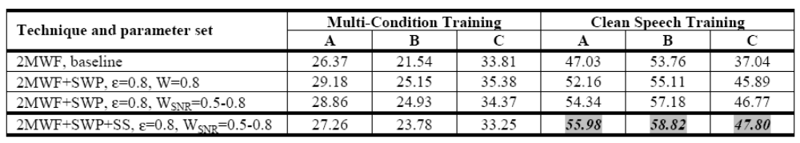
Table 3

